Slide 1

In the name of GOD
5W+1H pattern: A perspective of systematic mapping studies and a case study on cloud software testing
Presenters:
Zari Shamsa, Mohammad Amini
(PhD. Candidates)
Professor:
Dr. Ali Rezaei
Jan - 2017
Islamic Azad University, Science and Research Branch

Slide 2
Contents
Introduction
A 5W+1H pattern-based approach
Feasibility case study of applying the 5W+1H pattern: a mapping study of CST interface
Paper identification process
Quality assurance
Conclusion

Slide 3
Software testing and Cloud Computing
Software testing
Cloud computing
Software testing consumes at least 30% of the whole software development budget.
Cloud computing aims at providing a highly customizable and resourceful platform to deploy software.
Does cloud computing solve or amplify the issues faced by software testing?

Slide 4
mapping study
Systematic literature review (SLR) is a dominant approach to conducting survey on a research topic.
Mapping study (MS) is “a more ‘open’ form of an SLR.
At the core of a typical SLR, including an MS, is a well-defined literature review protocol.

Slide 5
mapping study
We observe that existing work on MS methodology focuses on managing the processes of either literature search or article categorization.
To the best of our knowledge, none of the existing work has provided a systematic way to explore the formulation of RQs in an MS. In this paper, we address this problem.

Slide 6
mapping study
We propose an architectural style based on the 5W+1H (Who, Why, What, Where, When and How) model.
We validate the feasibility of our proposal via a two-phase case study of the MS of CST interface.

Slide 7
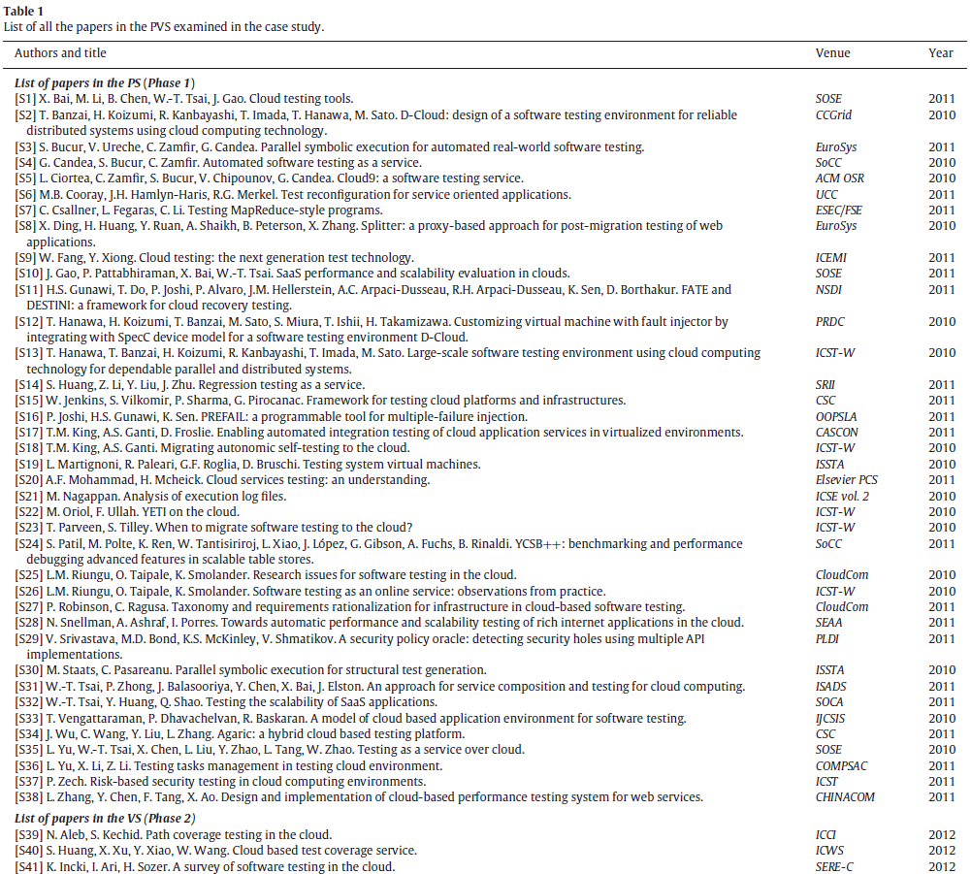

Slide 8
Our work consists of three parts:
In the first part, we proposed a 5W+1H pattern to structure RQs and contrast the questions with the findings from the MS.
In the second part, we applied the 5W+1H pattern to conduct a case study of an MS of CST-interface research.
In the third part, we reflected on the experiences from our two-phase case study on CST interface.

Slide 9
5W+1H model
The term “5W+1H” is an abbreviation of six keywords: Who, Why, What, Where, When, and How.
The 5W+1H model represents the majority needs of what people want to know about a news story.
Kipling, an English writer, first mentioned the 5W+1H model in his book entitled Just So Stories (Kipling, 1902) in 1902. Later, journalists widely applied this model to report news.

Slide 10
5W+1H model
From the perspective of journalists, to report a story, the readers should be supplied with essential information on six questions:
(1) Who performed the actions in the story (or who experienced the results)? [Actor]
(2) Why did the actions occur? [Motivation]
(3) What were the actions and what happened as a result of the ac-tions? [Content]
(4) Where did the actions take place? [Location]
(5) When did the actions occur? [Time]
(6) How did the actions connect to each other? [Causality]

Slide 11
5W+1H model
The 5W+1H model provides six dimensions to completely report events of interest.
We propose that it can benefit MS investigators by relieving their challenges in defining the initial set of RQs and providing them with guides to perspectives that are not necessarily seen from other MSs in similar topics (such as service-based testing versus software testing).
In the next section, we will elaborate our view on how to apply the 5W+1H model to MS.

Slide 12
Applying the 5W+1H model to a mapping study
Specifically, we adapt the 5W+1H model to the context of con-ducting an MS of a research topic and formulate a 5W+1H pattern that helps us define and focus on the initial RQs for studying the topic.
(1) Who: the researchers
(2) Why: the motivations and objectives of proposing the research problems
(3) What: the research ideas and issues

Slide 13
Applying the 5W+1H model to a mapping study
(4) Where: the locations of the research problems in terms of their positions in the topic context and venues of publication
(5) When: the publication date
(6) How: the interconnections among individual problems
Our MS case study was framed and guided by the above 5W+1H pattern. Specifically, we formulated a set of RQs for exploring CST-interface research from the six dimensions of the 5W+1H pattern.

Slide 14
Feasibility case study of applying the 5W+1H pattern: a mapping study of CST interface
the process of our feasibility case study, including:
the formulation of RQs by applying the 5W+1H pattern
the identification of the paper sets for the two phases of the MS
the quality assurance
data analysis tasks.

Slide 15
The 5W+1H pattern
To portray a contemporary picture of CST-interface research, we adopted the 5W+1H pattern and then instantiated it into the context of studying the topic of CST-interface research to pre-propose one RQ for each of the six dimensions as follows:
RQ1: Who (which researchers or groups) were doing research in CST interface?
RQ2: Why were the research studies needed? That is, what research objectives were stated in the articles?

Slide 16
The 5W+1H pattern
RQ3: What kinds of software testing research ideas were presented in the articles?
RQ4: Where were the articles published? Did the articles appear in typical types of publication venues? On which cloud service architectural layers were the articles focused?
RQ5: When did the articles start to show impact? Were the articles immediately cited by other articles?
RQ6: How were the articles interreferenced among various software testing topics and cloud service architectural layers?

Slide 17
The 5W+1H pattern
Using the 5W+1H pattern, we further formulated a conjecture for each RQ according to the common perception of computer scientists.

Slide 18
The 5W+1H pattern
We started the MS by using the process described to identify a set of papers, reviewed them, and mapped out the research according to each RQ and conjecture.
We then enumerated the findings (in Tables 2 and 3) using the 5W+1H pattern as a template, followed by an overall assessment statement with respect to each RQ and conjecture.

Slide 19
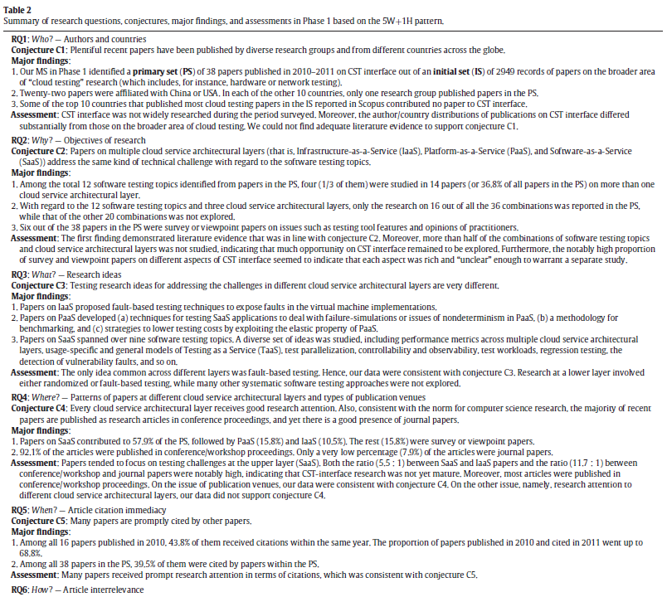

Slide 20
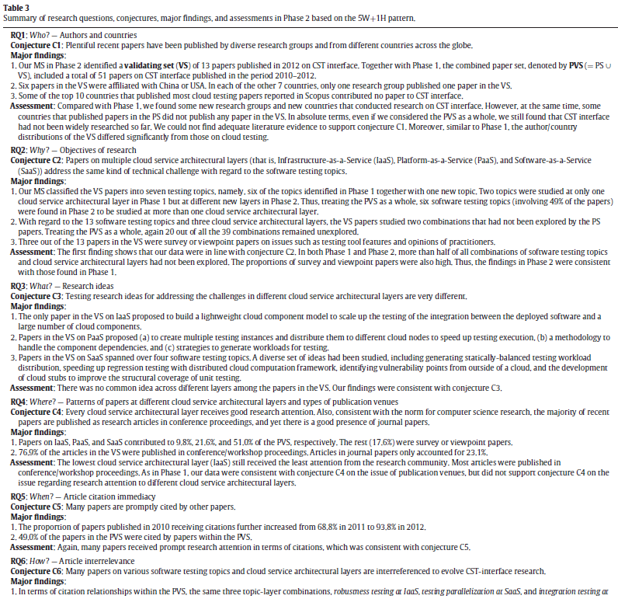

Slide 21
Paper identification process
In this section, we present the paper selection processes of our case study.
We note that the main goal of the case study is to demonstrate the feasibility of adopting the 5W+1H pattern in an MS.
Phase 1: Identification of the primary set (PS) of papers
Phase 1 of the case study was performed in June 2012.

Slide 22
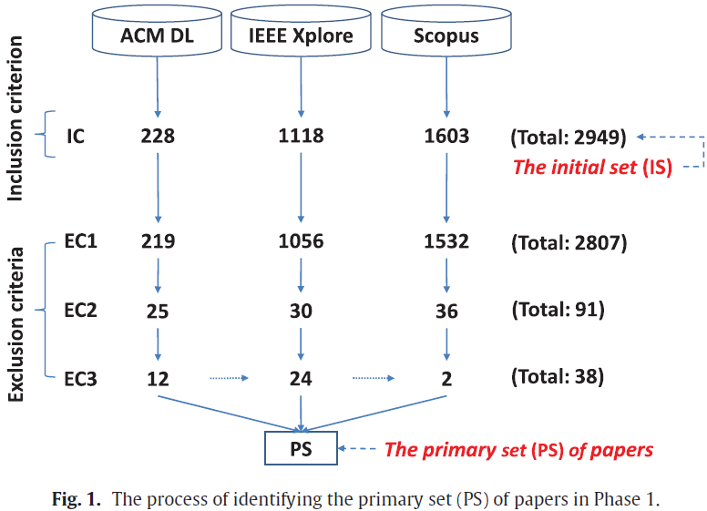
Fig. 1. The process of identifying the primary set (PS) of papers in Phase 1.
Fig. 1 depicts the paper search and selection process.

Slide 23
Paper identification process
Phase 2: Identification of the validating set (VS) of papers
Considering the validation purpose of Phase 2 instead of conducting a new MS, we chose to search papers in Scopus because of its largest literature coverage among the three databases used in Phase 1.
By executing this search query in June 2013, we extracted 43 papers from Scopus.
We refer to this collection of 43 papers, contributed by researchers from 22 countries, as V-Scopus. Considering the small size of V-Scopus, we directly read the abstract, introduction, and conclusion of each of the 43 papers, and finally obtained 13 papers published in 2012 that were relevant to CST-interface research, as listed in Table 1.
We refer to this set of 13 papers as the validating set (VS).

Slide 25
Quality assurance
We browsed the official website of the publication venue of each paper in the PVS to ascertain that it had been peer-reviewed.
Also, by manually reading the full text of each paper in the PVS (in addition to the preceding stages of examining its abstract, introduction, and conclusion), we verified that the paper indeed satisfied the inclusion criterion but was not eliminated by the exclusion criteria, with only a few exceptional papers that we nevertheless decided to include in the MS for the following reasons.

Slide 26
Resource
5W+1h pattern: A perspective of systematic mapping studies and a case study on cloud software testing
The Journal of Systems and Software 2015
journal homepage: www.elsevier.com/locate/jss

